Slide 1
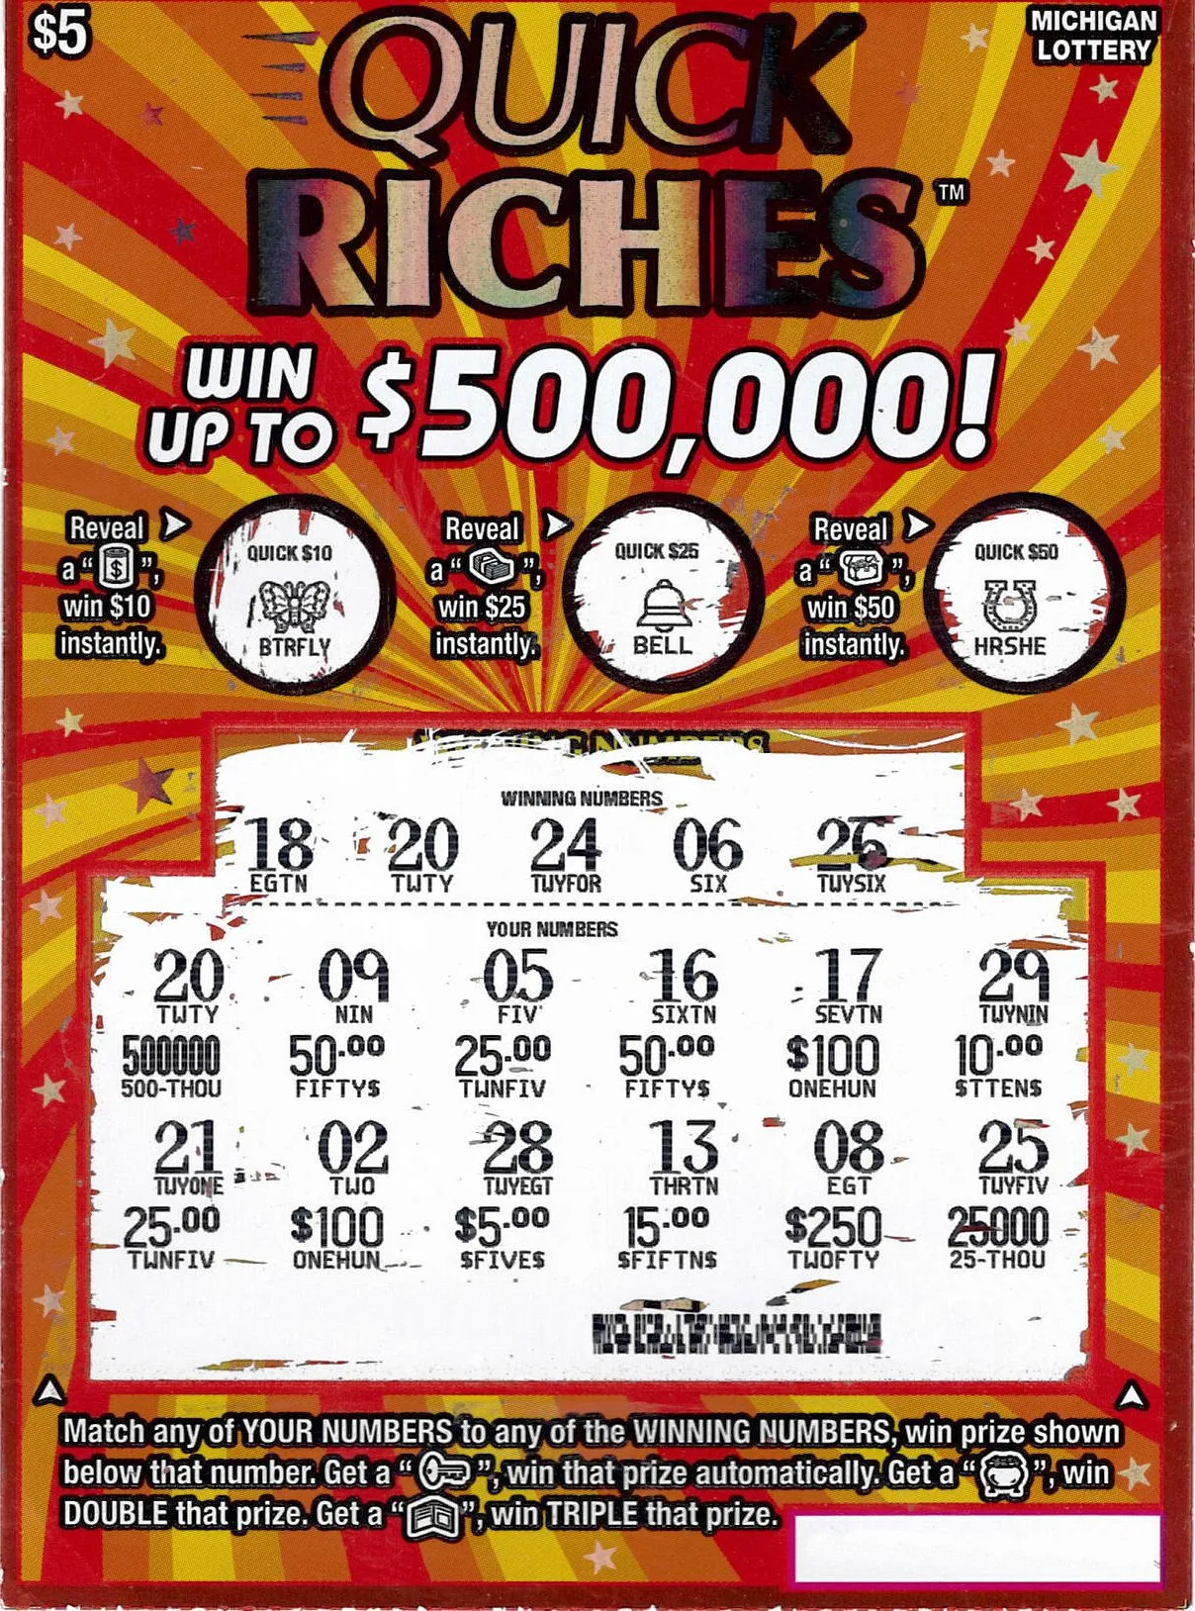
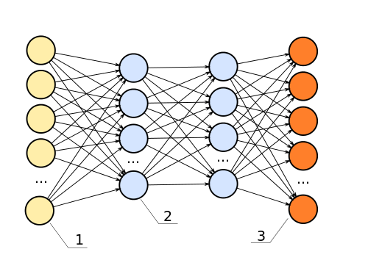
The Lottery Ticket Hypothesis
paper by Jonathan Frankle and Michael Carbin @ MIT CSAIL [link]
presentation by Jack Morris
12/1/19
https://qdata.github.io/deep2Read/

Slide 2
Background: Pruning
To reduce the size of a neural network by removing unwanted parts
People have been trying to prune neural networks for awhile
Idea originated into 1990s

Slide 3
The Pruning Process
What structure?
Weights? Neurons? Filters? Channels? Layers?
Train the network
Remove superfluous structure
Fine-tune the network
[optional] iteratively repeat steps 2 and 3
What does “superfluous” mean?
Magnitudes? Gradients? Activations?

Slide 4
Motivation
As you may imagine, lots of groups have tried something like this before
“Training a pruned model from scratch performs worse than retraining a pruned model, …, which may be due to the difficulty of training small networks from scratch” – Pruning Filters for Efficient ConvNets

Slide 5
Motivating Questions
Can we train sparsely pruned networks from scratch? Yes
Corollary: Do networks have to be overparameterized to learn? No
There’s a catch: Need to reuse the weight initializations from the original training process.

Slide 6
Training Pruned Networks
Randomly initialize the network’s weights
Train it and prune superfluous structure
Reset each remaining weight to its value from 1
Repeat and 💰 PROFIT 💰

Slide 7
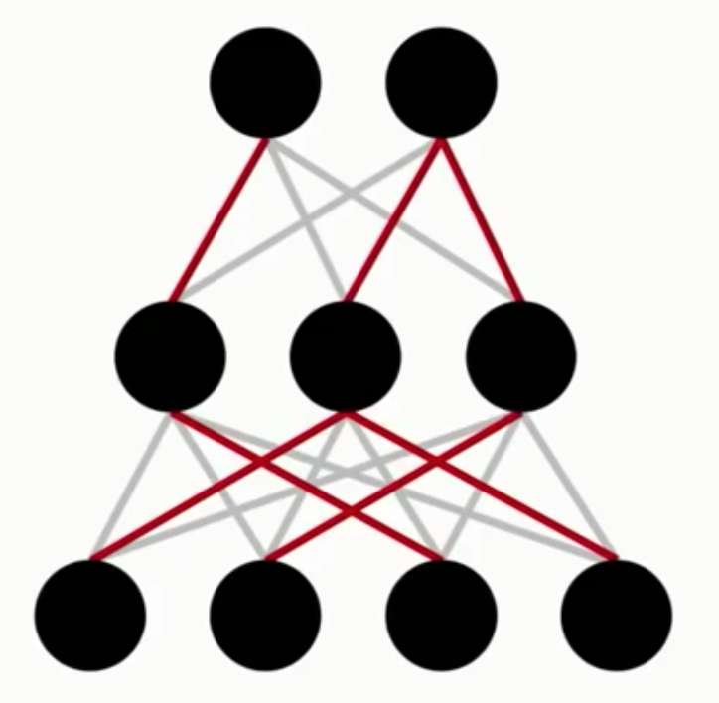
Training Pruned Networks

Slide 8
Training Pruned Networks
Giant appendix shows that this works with batch normalization, dropout, convolutional layers, weight decay, residual connections, optimizers, etc. for any hyperparameter choices
Caveats:
1. If you randomly reinitialize the network, this won’t work
2. You still have to train the network first (so it’s not a particularly efficient process)

Slide 9
Training Pruned Networks
So to recap, these small subnetworks:
1. Are between 15% and 1% of the original size
2. Learn faster than the original network
3. Reach the same or higher test accuracy

Slide 10
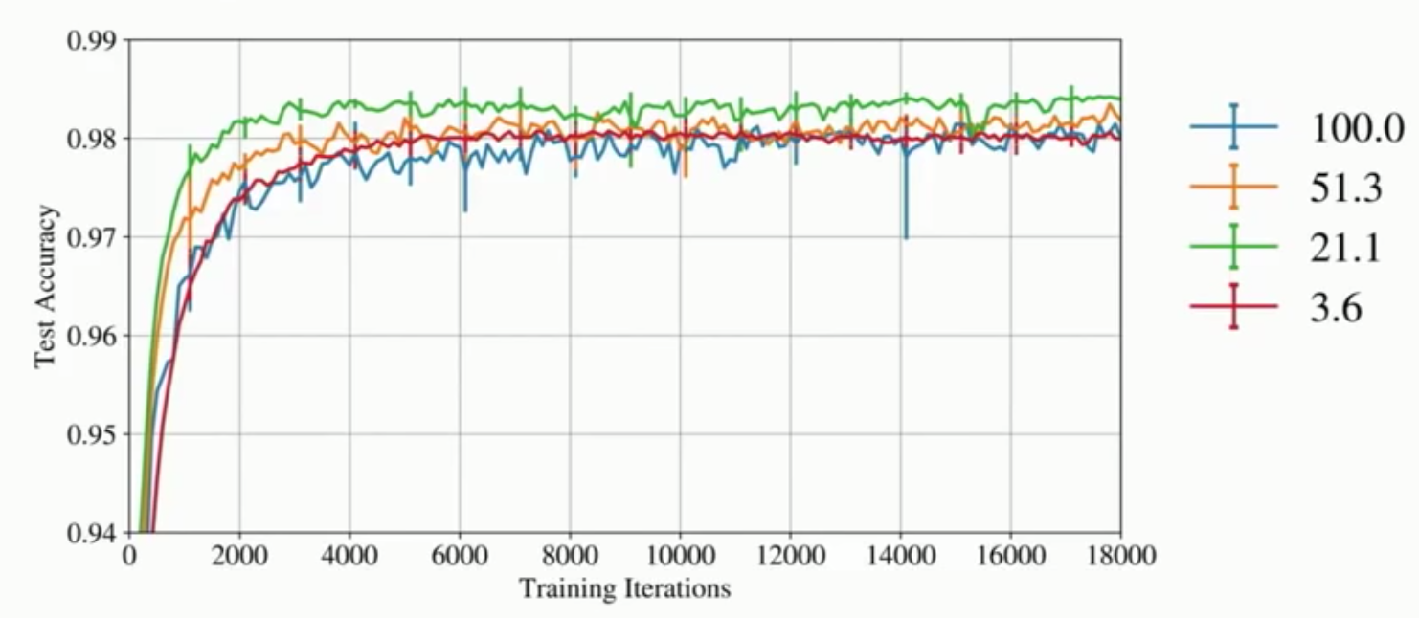
Results
LeNet 300-100-10 for MNIST / fully-connected / 300k parameters

Slide 11
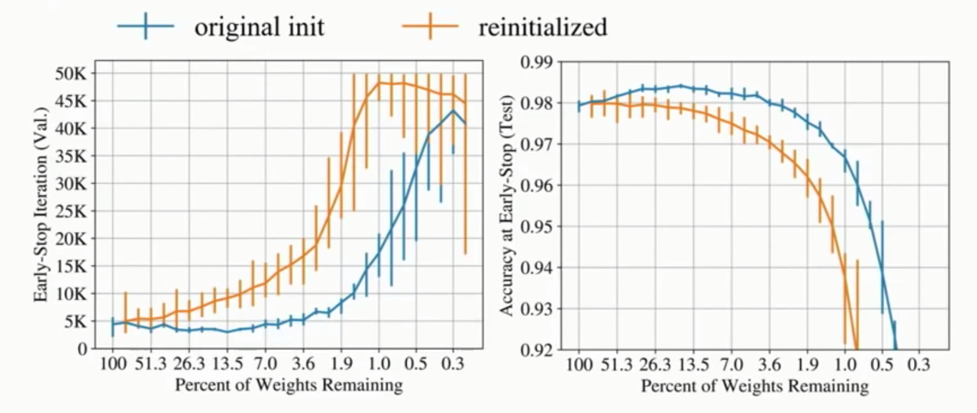
Results
LeNet 300-100-10 for MNIST / fully-connected / 300k parameters

Slide 12
The Lottery Ticket Hypothesis
Plain English:
Dense, trainable networks have sparse trainable subnetworks that are equally capable
Formally:
f(x; W) reaches accuracy a in t iterations
f(x; m∘W) reaches accuracy a’ in t’ iterations
∃m | ∑m << w a’ ≥ a t’ ≤ t

Slide 13
Possible future work
Finding a way to prune networks early in training
Examining these subnetworks to see what works– use this info to develop better architectures and initializations
Make good subnetworks and reuse them on tasks
(A good test for overfitting, too)
Stabilizing the Lottery Ticket Hypothesis (Frankle, 2019)
Prune after a few iterations, not at t=0
Compress ResNet-50, Inception-v3 in one shot by over 50%!

Slide 14
Questions?

